Slide 1
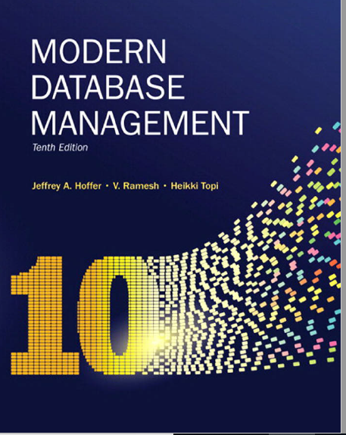
Chapter 5: Physical Database Design and Performance
Notes:
So far, we have covered conceptual, logical, and today we will cover physical database design

Slide 2
Objectives
Define terms
Describe the physical database design process
Choose storage formats for attributes
Select appropriate file organizations
Describe three types of file organization
Describe indexes and their appropriate use
Translate a database model into efficient structures
Know when and how to use denormalization

Slide 3
Physical Database Design
Purpose–translate the logical description of data into the technical specifications for storing and retrieving data
Goal–create a design for storing data that will provide adequate performance and ensure database integrity, security, and recoverability
Notes:
Purpose is to achieve optimal performance . In the age of big data, and terabytes, petabyte db, it is important to have an optimal physical database design.

Slide 4
Information Needed for Physical Design
Normalized relations, including estimates for the range of the number of rows in each table
Definitions of each attribute, along with physical specifications such as maximum possible length
Descriptions of where and when data are used in various ways (entered, retrieved, deleted, and updated), including typical frequencies of these events
Expectations or requirements for response time and data security, backup, recovery, retention, and integrity
Descriptions of the technologies (database management systems) used for implementing the database
Notes:
Much of the input to the physical design comes from outputs from requirements analysis and logical design. Others stem from business security concerns and regulatory compliance, while still others stem from predictions of demand and performance analysis.
At the point where you need to design a physical db:
Normalized relations -> if it is a relational system, 3NF, Volume estimates: GB, PB etc
Attribute definitions
Response time expectations: Business requirements
Data security needs: Are there regulations you need to keep in mind. Security data such as CC, SS#, which encryption algorithm
Backup/recovery needs: daily, incremental etc
Integrity expectations
DBMS technology used: Oracle, DB2, Postgress, MySQL, SQL Server
Decision during database physical DB design :
Attribute data types --- what type of data types. ASCII, Unicode ( international customers… Primary key int 32 bit vs 64 bit
Physical record descriptions ()
File organizations : for large dbs it is important
Indexes and database : used for optimal reads
Query optimization: how do you optimize your query to run fast

Slide 5
Critical Decisions for Physical Design
Choosing the storage format (called data type) for each attribute from the logical data model
Giving the D B M S guidance regarding how to group attributes from the logical data model into physical records
Giving the D B M S guidance on how to arrange similarly structured records in secondary memory (file organization)
Selecting structures (including indexes and the overall database architecture) for storing and connecting files to make retrieving related data more efficient
Preparing strategies for handling queries against the database that will optimize performance (query optimization)
Notes:
The primary goal of physical database design is data processing efficiency.
The organizational role that typically has the primary responsibility for physical database design is called the database administrator (DBA). More about database administration in Chapter 12.

Slide 6
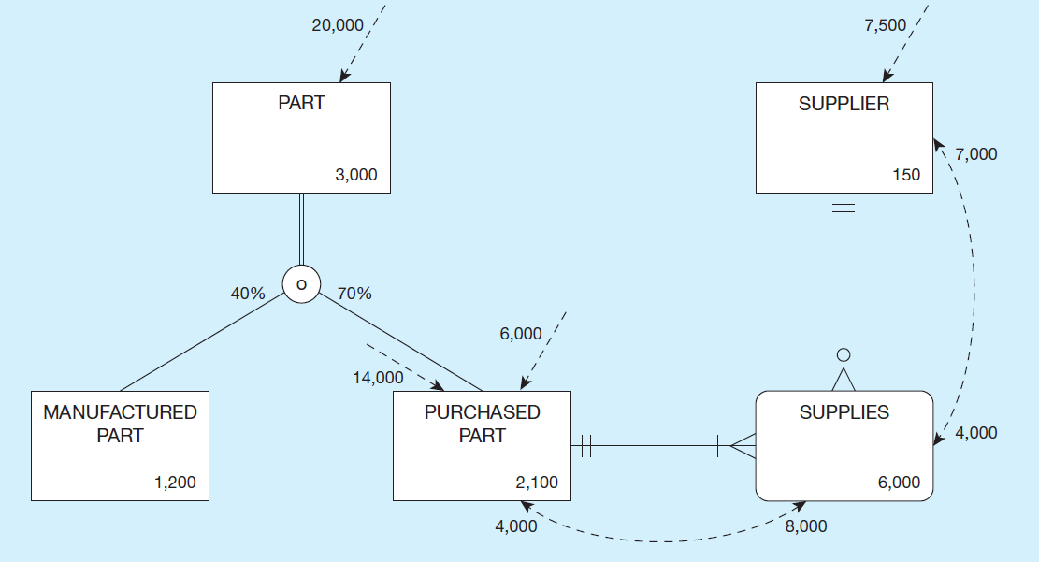
Composite Usage Map (Pine Valley Furniture Company)
Notes:
We create usage maps by modifying EER diagrams to include information regarding sizes of entities (e.g. numbers of instances) as well as frequencies of use of these entities. In this way, we come to an understanding of the storage needs, as well as the computational demand of the system. Usage analysis should be an ongoing activity.
Data volume
Here we see an expectation of 3000 parts, subdivided into manufactured and purchased. We also see 150 suppliers, and we see 6000 associations, each of which describe a particular supplier providing a particular purchased part (referred to in the next slides as a quotation). You can think of each entity as a table containing that number of rows (records).
Access Frequencies (per hour)
The volume and frequency statistics are generated during the systems analysis phase of the systems development process when systems analysts are studying current and proposed data processing and business activities. The data volume statistics represent the size of the business and should be calculated assuming business growth over a period of at least several years. The access frequencies are estimated from the timing of events, transaction volumes, the number of concurrent users, and reporting and querying activities.
Usage analysis:
14,000 purchased parts accessed per hour ➔
8000 supplies accessed from these 14,000 purchased part accesses ➔
7000 suppliers accessed from these 8000 supplies accesses
Note that the access of data from one table may trigger the need for further accesses in other tables. Usage analysis includes providing a representation of this expected flow of access requests.
Usage analysis:
7500 suppliers accessed per hour ➔
4000 supplies accessed from these 7500 supplier accesses ➔
4000 purchased parts accessed from these 4000 supplies accesses
The flow can go in different directions. In the previous slide the flow was triggered by accesses to parts and flowed through purchased part, supplies (associations), and finally suppliers. In this slide we see a flow in the opposite direction, triggered by initial access requests for suppliers.
These access requests could be queries which retrieve data or updates which manipulate the data. Each of these imposes some demand on computing resources, so this type of modeling helps to express that demand.

Slide 7
Designing Fields
Field: smallest unit of data in database
Field design
Choosing data type
Coding, compression, encryption
Controlling data integrity
Notes:
After compiling the volume and usage analysis estimates.
You need to design the fields, or the columns associated in for each relation in our data model!
3 important aspect of the fields:
Choosing data type
Coding, compression, encryption
Controlling data integrity

Slide 8
Choosing Data Types
CHAR–fixed-length character
VARCHAR–variable-length character (memo)
LONG–large number
NUMBER–positive/negative number
INTEGER–positive/negative whole number
DATE–actual date
BLOB–binary large object (good for graphics, sound clips, etc.)
Notes:
Below are examples of data types
What data type would you choose for FirstName,
What type of data type would you choose for student ID?
What type of datatype would you choose a song?

Slide 9
SQL Server Data Types
Numeric:
Int, bigint, decimal, money, smallint, bit
Date and Time
Date, datetime, time, samlldatetime
Character string
Char, varchar
Unicode
Nchar, nvarchar
Notes:
Some of these data types can vary from db to d

Slide 10
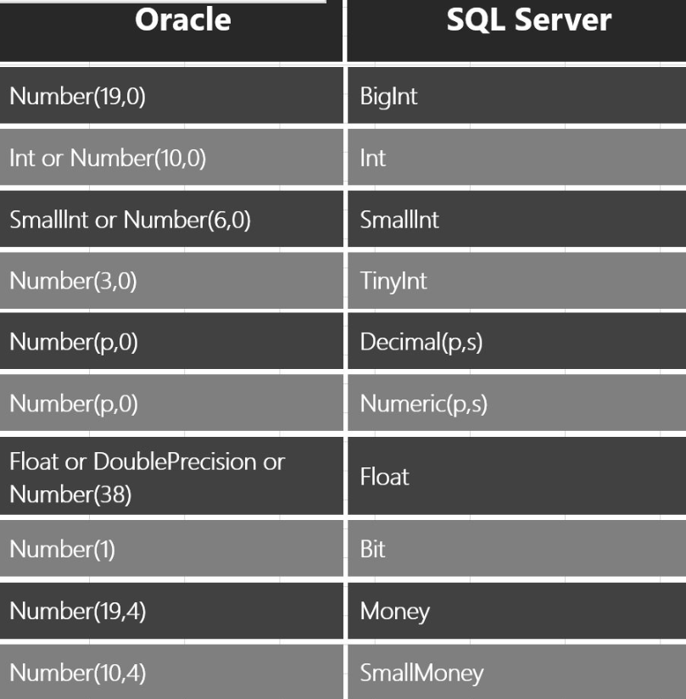
SQL Server/Oracle Data Types
https://blog.sqlauthority.com/2016/06/14/sql-server-oracle-numeric-datatype-mapping/

Slide 11
Field Data Integrity
Default value–assumed value if no explicit value
Range control–allowable value limitations (constraints or validation rules)
Null value control–allowing or prohibiting empty fields
Referential integrity–range control (and null value allowances) for foreign-key to primary-key match-ups
Notes:
How do you ensure only the data types that you want are stored in your tables?
Default value– when not provided by users, it is defaulted to a specific value.
Range control–allowable value limitations - maybe you only allow a score from 0-5.
Null value control–allowing or prohibiting empty fields. Required field vs. non-required field
Referential integrity–range control (and null value allowances) for foreign-key to primary-key match-ups.

Slide 12
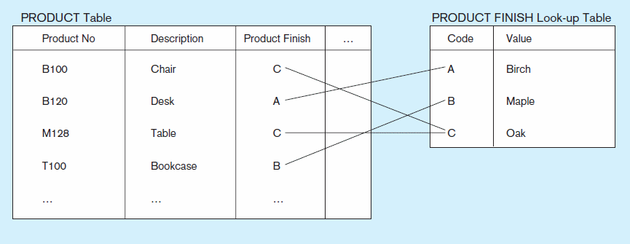
Figure 5-2 Example of a code look-up table
(Pine Valley Furniture Company)
Code saves space, but costs an additional lookup to obtain actual value
Notes:
Other way to optimize a field:
When you have large tables, it is always a good idea to use look up tables instead of values directly into that table

Slide 13
Designing Physical Database Files
Physical File
A named portion of secondary memory allocated for the purpose of storing physical records
Tablespace – named logical storage unit in which data from multiple tables/views/objects can be stored
Tablespace components
Segment – a table, index, or partition
Extent – contiguous section of disk space
Data block – smallest unit of storage
Notes:
We’ve been talking about relational database structures, involving tables, columns, and primary and foreign keys, as if this is in fact the way data is stored on disk. But it is not. At the operating system level, we are always talking about files. Databases are just one kind of file. The table/column/key idea is really an abstraction. At a lower implementation level, these database files (like all physical files) are constructed via different file formats, which will be discussed in the next few slides.
Most database management systems store many kinds of data in one operating system file. By an operating system file, we mean a named file that would appear on a disk directory listing (e.g., a listing of the files in a folder on the C: drive of your personal computer).
OS smallest unit is bytes, Databases uses their own units of storage and it is called data blocks.

Slide 14
Physical Records
Physical Record: A group of fields stored in adjacent memory locations and retrieved together as a unit
Page: The amount of data read or written in one I/O operation
Blocking Factor: The number of physical records per page
Notes:
Physical record are stored in together is disks as a unit.
Page: in one I/O operation, the amount of data that is read or written.
Blocking factor: number of physical records per page
Some database systems, nowadays all databases systems stores frequently accessed data into RAM ( it your server had adequate) or what’s called page files.

Slide 15
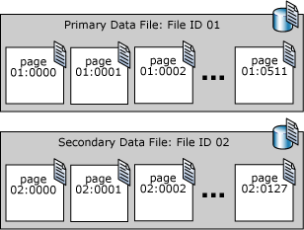
Page File
Notes:
A SQL Server page is 8K -> 8 contiguous group 64k called an extend
When design a database, you must allocate memory for your database – allocate the actual disk storage
Tablespaces/ FILEGROUP for SQL is the named set of disks where your physical tables are stored
A SQL Server page is 8K -> 8 contiguous group 64k called an extend

Slide 16
Types of File Organizations
Heap – no order
Sequential
Indexed
Hashed
Notes:
A file organization is a technique for physically arranging the records of a file on secondary storage devices. Typical file organizations include sequential, indexed, and hashed, which we will see in the next few slides. Another possibility is something called a “heap”, but this has no order and is not ideal for quick access. Imagine a telephone book where people were in no particular order. You’d potentially have to search through each and every name before finding what you need. The other file organizations are designed to bring quick access and/or optimize insertion, modification, and removal of data items.
With modern relational DBMSs, you don’t need to design file organizations, but you may be allowed to select an organization and its parameters for a table or physical file. Here are some factors to consider.

Slide 17
Factors for selecting file organization
Fast data retrieval and throughput
Efficient storage space utilization
Protection from failure and data loss
Minimizing need for reorganization
Accommodating growth
Security from unauthorized use
Notes:
With modern relational DBMSs, you don’t need to design file organizations, but you may be allowed to select an organization and its parameters for a table or physical file. Here are some factors to consider.

Slide 18
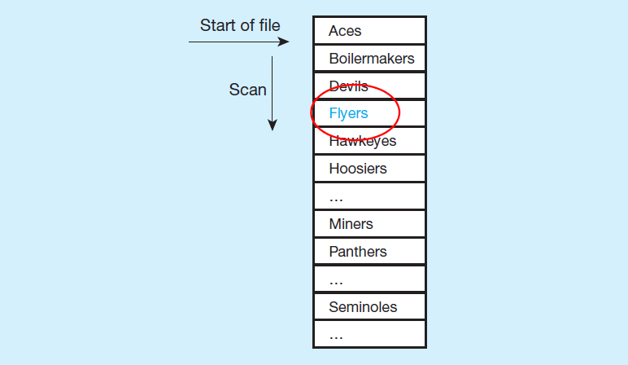
Comparison of File Organizations
a) Sequential
Notes:
In essence, when data is arranged sequentially, you can cut the search space in half each time you look. For example, suppose you wanted to find the Flyers? First, look at the middle item the list (suppose it was Hoosiers). Since Flyers come before Hoosiers, you know it has to be in the group before Hoosiers. So, then look in the middle of that group (suppose this item was Devils. At this point, you know it has to be between Devils and Hoosiers.
So, the speed of accessing a desired record (knowing the primary key) in a sequential file is much, much faster than accessing it in an unordered file (heap).
But, sequential file organization always requires data to be sorted. Therefore, such a file must be resorted every time new items are inserted, or if any existing items are changed. So, the speed of access comes with a significant maintenance cost.

Slide 19
Indexed File Organizations
Storage of records sequentially or nonsequentially with an index that allows software to locate individual records
Index: a table or other data structure used to determine in a file the location of records that satisfy some condition
Primary keys are automatically indexed
Other fields or combinations of fields can also be indexed; these are called secondary keys (or nonunique keys)
Notes:
In an indexed file organization, the records are stored either sequentially or nonsequentially, and an index is created that allows the application software to locate individual records (see Figure 8-7b). Like a card catalog in a library, an index is a table that is used to determine in a file the location of records that satisfy some condition. Each index entry matches a key value with one or more records. An index can point to unique records (a primary key index, such as on the ProductID field of a product record) or to potentially more than one record. An index that allows each entry to point to more than one record is called a secondary key index.

Slide 20
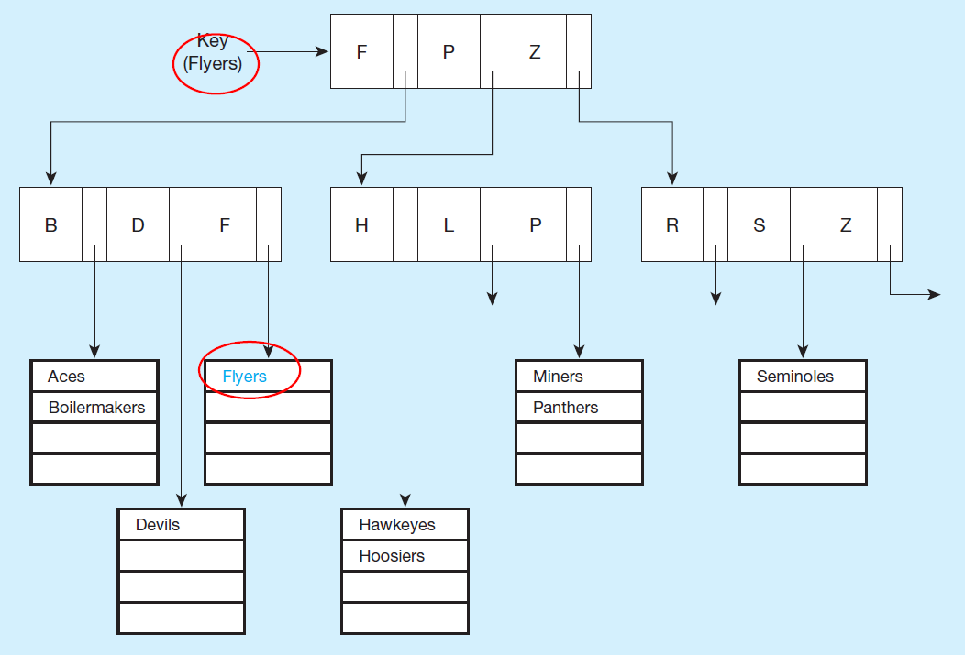
Comparison of File Organizations (1 of 2)
a) Indexed
Notes:
An advantage of the indexed file organization over the sequential is that it is easier to insert and delete data. Because the index is composed of many smaller lists of actual data items (seen in the bottom of the tree), then sorting an individual cluster is much less costly than sorting the whole file. Also, if you keep the individual lists small enough, then even if they are unsorted, the search time is not so bad.
The trick is indexing, and specifically keeping an optimal number of levels within the index. In this case we see two levels of indexing, below which are the sub lists of data items.
The index organization in this figure splits at the top level into three groups. Any team name starting with A-F goes in the first group, those with G-P in the second, and those with Q-Z in the third. Within each group there is a second split into three subgroups each.
Indexed file organization is often used with attributes that are likely to be frequently used in queries. Part of the physical design process involves choosing which columns of a table to index, as we’ll see later.

Slide 21
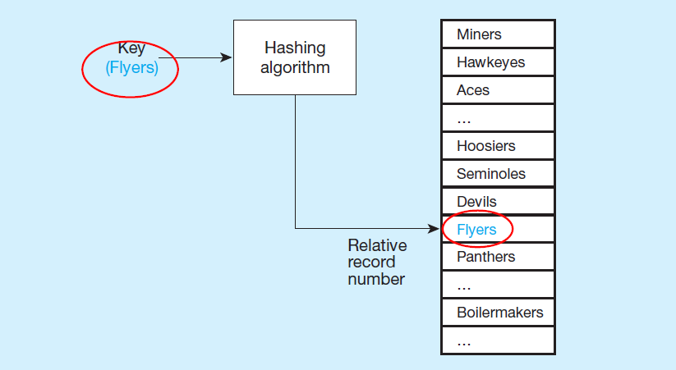
Comparison of File Organizations (2 of 2)
a) Hashed
Notes:
A hashing algorithm is a routine that converts a primary key value into a record address. Although there are several variations of hashed files, in most cases the records are located nonsequentially, as dictated by the hashing algorithm. Thus, sequential data processing is impractical.
A typical hashing algorithm uses the technique of dividing each primary key value by a suitable prime number and then using the remainder of the division as the relative storage location. For example, suppose that an organization has a set of approximately 1,000 employee records to be stored on magnetic disk. A suitable prime number would be 997, because it is close to 1,000. Now consider the record for employee ID 12396. When we divide this number by 997, the remainder is 432. Thus, this record is stored at location 432 in the file.
Hashing algorithms could potentially map two different primary keys to the same location. If that happens, there will be a list at that location, similar to the lists in the indexed file organization described earlier.

Slide 22


Unique and Non unique Indexes
Unique (primary) Index
Typically done for primary keys, but could also apply to other unique fields
,
Non unique (secondary) index
Done for fields that are often used to group individual entities (e.g., zip code, product category)
,
Notes:
Part of the physical design process is to decide which fields need indexing. Primary keys are normally indexed by default. The database designer typically chooses which other fields to index, based on expected usage of those fields in queries and inserts. If the fields are used a lot as conditions in queries, this increases the importance of indexing. But indexing comes at a cost, which involves maintaining the index. Indexes are costly for fields that get updated a lot.

Slide 23
Denormalization
Transforming normalized relations into non-normalized physical record specifications
Benefits:
Can improve performance (speed) by reducing number of table lookups (i.e. reduce number of necessary join queries)
Costs (due to data duplication)
Wasted storage space
Data integrity/consistency threats
Notes:
It might seem counterintuitive that a database designer would want to denormalize a previously normalized (well structured) set of relations. After all, we spent considerable effort towards conceptual modeling (E-R/ EER) in order to ensure well-structured logical design. And, when faced with poorly structured relations, we normalized them in our logical design. Why denormalize now?
The answer is performance. When you normalize, you split data into separate tables in order to eliminate or at least reduce data duplication. This helps to ensure data integrity. But, it comes at a cost. It is much more computationally efficient to query a single table than to query multiple tables.
Therefore, it makes sense to, in a controlled way, back off from perfect normalization. In the next few slides, we’ll see some examples.

Slide 24
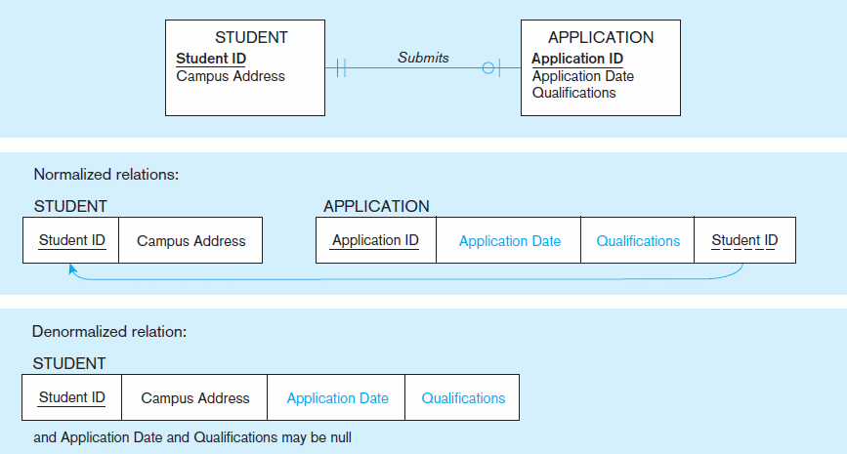
Figure 5-3 A possible denormalization situation: two entities with one-to-one relationship

Slide 25
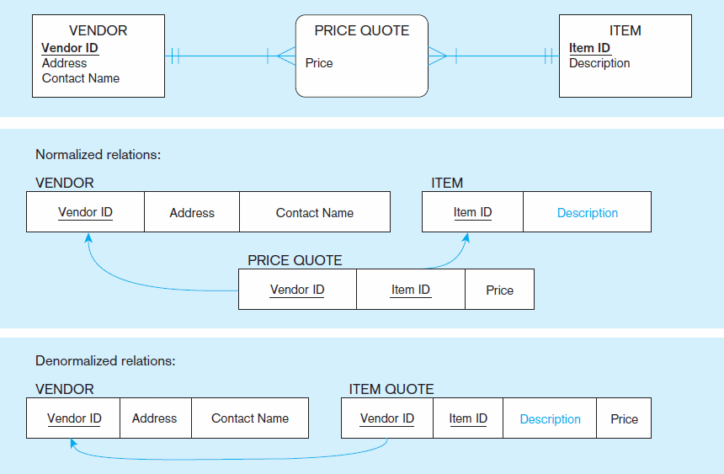
Figure 5-4 A possible denormalization situation: a many-to-many relationship with nonkey attributes
Extra table access required
Null description possible

Slide 26
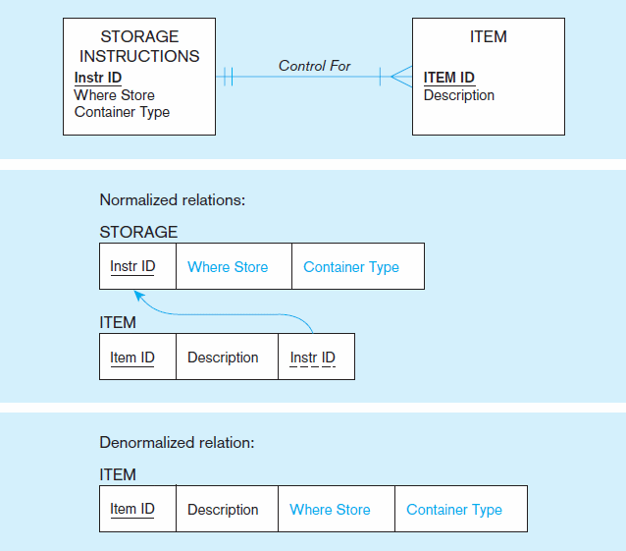
Figure 5-5
A possible denormalization situation:
reference data
Extra table access required
Data duplication

Slide 27
Denormalize with Caution
Denormalization can
Increase chance of errors and inconsistencies
Reintroduce anomalies
Force reprogramming when business rules change
Perhaps other methods could be used to improve performance of joins
Organization of tables in the database (file organization and clustering)
Proper query design and optimization
Notes:
Note that denormalization is most beneficial and least harmful in relations where there is a minimal amount of updates that would occur to the duplicated attributes. In Chapter 9, we will discuss the concept of “data warehouses”. A data warehouse is generally for the sole purpose of performing complex queries to assist with managerial decision making. These are never updated, except at specified intervals of data integration. Therefore, data warehouses are often non-normalized.

Slide 28
Partitioning
Horizontal Partitioning: Distributing the rows of a logical relation into several separate tables
Useful for situations where different users need access to different rows
Three types: Key Range Partitioning, Hash Partitioning, or Composite Partitioning
Vertical Partitioning: Distributing the columns of a logical relation into several separate physical tables
Useful for situations where different users need access to different columns
The primary key must be repeated in each file
Notes:
You can also have combinations of Horizontal and Vertical.
The previous denormalization examples all deal with combining tables to avoid doing joins. Another form of denormalization involves the creation of more tables by partitioning a relation into multiple physical tables.
In other words, we purposely duplicate (copy) relations or portions of relations and store these copies in multiple storage locations.

Slide 29
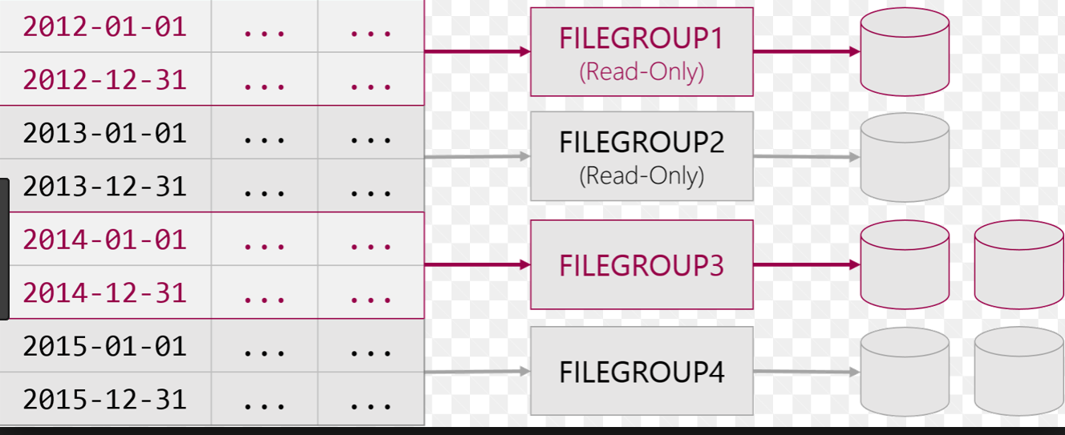
Example of Horizontal Partitioning (range)
https://www.cathrinewilhelmsen.net/2015/04/12/table-partitioning-in-sql-server/
Notes:
What are the advantages of partitioning :
Efficiency: Records used together are grouped together
Local optimization: Each partition can be optimized for performance
Security: data not relevant to users are segregated
Recovery and uptime: smaller files take less time to back up
Load balancing: Partitions stored on different disks, reduces contention
Disadvantages of Partitioning:
Inconsistent access speed: Slow retrievals across partitions
Complexity: Non-transparent partitioning
Extra space or update time: Duplicate data; access from multiple partitions

Slide 30
Advantages of Partitioning
Efficiency: Records used together are grouped together
Local optimization: Each partition can be optimized for performance
Security: data not relevant to users are segregated
Recovery and uptime: smaller files take less time to back up
Load balancing: Partitions stored on different disks, reduces contention

Slide 31
Disadvantages of Partitioning
Inconsistent access speed: Slow retrievals across partitions
Complexity: Non-transparent partitioning
Extra space or update time: Duplicate data; access from multiple partitions

Slide 32
Oracle 11g Horizontal Partitioning Methods
Range partitioning
Partitions defined by range of field values
Could result in unbalanced distribution of rows
Like-valued fields share partitions
Hash partitioning
Partitions defined via hash functions
Will guarantee balanced distribution of rows
Partition could contain widely varying valued fields
List partitioning
Based on predefined lists of values for the partitioning key
Composite partitioning
Combination of the other approaches

Slide 33
Clustering Files
In some relational DBMSs, related records from different tables can be stored together in the same disk area
Useful for improving performance of join operations
Primary key records of the main table are stored adjacent to associated foreign key records of the dependent table
e.g. Oracle has a CREATE CLUSTER command, SQL Server does not!
Notes:
Cluster -> data stored in the same disk area to improve operations.
This is rare. But it is a tool that exists

Slide 34
Rules for Using Indexes
Use on larger tables
Index the primary key of each table
Index search fields (fields frequently in WHERE clause)
Fields in SQL ORDER BY and GROUP BY commands
When there are >100 values but not when there are <30 values

Slide 35
Rules for Using Indexes (cont.)
Avoid use of indexes for fields with long values; perhaps compress values first
Notes:
Is it a good idea to create index on every column

Slide 36
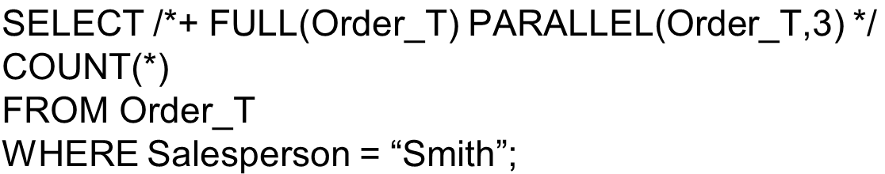

Query Optimization
Parallel query processing – possible when working in multiprocessor systems
Overriding automatic query optimization allows for query writers to preempt the automated optimization
Oracle example:
clause is a hint to override Oracle’s default query plan

